Slide 1




Not All Claims are Created Equal: Choosing the Right Statistical Approach to Assess Hypotheses
arxiv.org/abs/1911.03850
Erfan Sadeqi-Azer (Indiana U → Google) Ashish Sabharwal (AI2) Dan Roth (UPenn).
Notes:
Hello everybody! This talk is a tutorialized version of a recent paper we have published.
- It is about experimentation and drawing conclusions about your results.
- Not only this is meant to be a tutorial for those who are not familiar with the subject,
- I promise to show you some new intuitions, for those who're already familiar.
While we tend to focus on the NLP research community, these ideas are by no means limited to NLP. You can apply them to other research project, or even many applied problems that require some form of decision-making.
The topic is often studied with great mathematical rigor, which unfortunately could make it less accessible. Here my effort is to stay as far as possible with complex equations and stick to the intuition.

Slide 2
The Cycle of Empirical Research
Hypothesis, or a General Premise
????
Research
Problem
Assessment/
Verification
Empirical Observations
Notes:
Let's start by talking about a typical empirical research.
The beginning of the cycle starts with curious lab experiments and empirical observation.
The observations result in research problem Questions about: what, or why something is happening.
Based on the observations we form “hypotheses” that could explain our intuition and assess them.
Here is the focus of this work. We study different hypotheses, the question they address and their assessment.

Slide 3
Hypotheses
A prediction about how the world will behave if our idea is correct
Worded as an if-then statement
A hypothesis is a testable prediction
A hypothesis is a falsifiable statement
Terminology:
A hypothesis is never “proved”
But it could be “supported” by the evidence
Notes:
Let's try to define "hypothesis" since it's gonna come up many times throughout this presentation.
A hypothesis is a prediction about how the world will behave if our idea is correct, and it is often worded as an if-then statement (e.g., if I study all night, I will get a passing grade on the test).
A hypothesis should be testable: try studying all night and see if you will pass the exam (good luck with that haha)
A scientific hypothesis is also falsifiable, or capable of being shown to be incorrect.
A small but important point about word choice:
A hypothesis is never “proved”, and it is better practice to use the terms “supported” :evidence could support a hypothesis and further research would built upon that.

Slide 4
Not a good statistical hypothesis
2020
2020
<
?
Notes:
Let's see an example:
Would the USA do better under a Sanders administrations, compared to a Buttigieg administration; this is actually not a good hypothesis; why not?
Because of course that's correct; is that even a question … sorry no politics.
There is no data to test, and therefore, it is neither testable nor falsifiable.
That was paid advertisement by Sanders campaign.

Slide 5
“I can always prepare a nice presentation, if I stay up the night before.”
Notes:
Here is another example:
(read)
This is actually a good hypothesis:
It is testable
It is also falsifiable.

Slide 6
A Typical AI Experiment
Can this apparent difference in performance be explained simply by random chance?
Do we have sufficient evidence to conclude that Ⓐ is in fact inherently stronger than Ⓑ on these datasets?
?
Hypothesis, or a General Premise
(Clark et al., 2018)
????
Research
Problem
System | Accuracy
Ⓐ | 72.4
Ⓑ | 68.9
Empirical Observations
|D|= 2376
Notes:
Let's see another example, taken from the context of AI problems:
Often times we like to build systems, and compare them on a single dataset:
Usually because we want to show the value of your contribution.
Here I am showing a table that contains the results of two QA systems S1 and S2 on Aristo’s ARC dataset.
Naturally, we want to make sense of these numbers.
While S1 has higher accuracy than S2 in both cases, the gap is moderate and the datasets are of limited size.
You ask yourself: (read) If the latter, can we quantify this gap in inherent strength while accounting for random fluctuation?

Slide 7
A Typical AI Experiment: Example Hypotheses
System | Accuracy
Ⓐ | 72.4
Ⓑ | 68.9
Spoiler Alert:
Almost everyone uses C1, even though it is harder to interpret.
C1*: Ⓐ and Ⓑ are inherently different, in the sense that if they were inherently identical, it would be highly unlikely to witness the observed 3.5% empirical gap.
C2*: Ⓐ and Ⓑ are inherently different, since with probability at least 95%, the inherent accuracy of Ⓐ exceeds that of Ⓑ by at least 𝛼%.
* Under some statistical assumptions about sampling of the observations.
And many more . . .
Notes:
Let’s see an example hypothesis about the numbers reported in this table
…
They sound similar, but if we go into details, they’re actually two different claims.
First, Ca is a conditional statement, which makes it like a proof by contradiction (more like hypothesis by contradiction).
This makes a big difference: while the second hypothesis is easier to interpret in terms of probability, the first one is relatively complex.
Well here is something that might come to you as a surprise: as I will show later in the talk (spoiler alert): …. (which is quite odd; that’s why I’m writing this paper).
Second, Cb goes further to claim a margin of at least 1% between their inherent accuracy.
Although here I am showing only two distinct claims about this empirical observations, ….

Slide 8
Hypothesis-1
Research Question
Hypothesis-2
Hypothesis-3
…
Observation 1: There are many different hypotheses that could address a single research question.
Notes:
… there are many hypotheses that (read)

Slide 9
Notes:
In fact, at the danger of taking this to extreme, there is a quote from Einstein that says ….

Slide 10
Hypothesis vs Statistical Techniques
Statistical Tool A
Hypothesis-1
Research Question
Statistical Tool B
Hypothesis-2
Statistical Tool C
Hypothesis-3
…
…
Observation 2: Each hypothesis ought to be assessed with an appropriate statistical tool.
Corollary: Researchers should start with a hypothesis that best serves their goal, followed by an appropriate selection of a statistical approach.
Notes:
But here is a tricky part: we don’t have a single statistical tool that could address any possible hypotheses in the world. Since each hypothesis starts with a different assumption and makes a (mathematically) different claim.
In fact, it is often the case that (read)
The corollary is that, (read)

Slide 11
Omission of hypotheses
Observation 3: Somehow, we tend to forget about hypotheses
Statistical Tool A
Hypothesis-1
Research Question
Statistical Tool B
Hypothesis-2
Statistical Tool C
Hypothesis-3
…
…
Notes:
However, in practice, it's usually the other way around.
We usually have a statistical test that we’re comfortable with and we apply it to our target data.
This issue is so severe that we often forget/ignore what is the hypothesis addressed by a statistical tool.

Slide 12
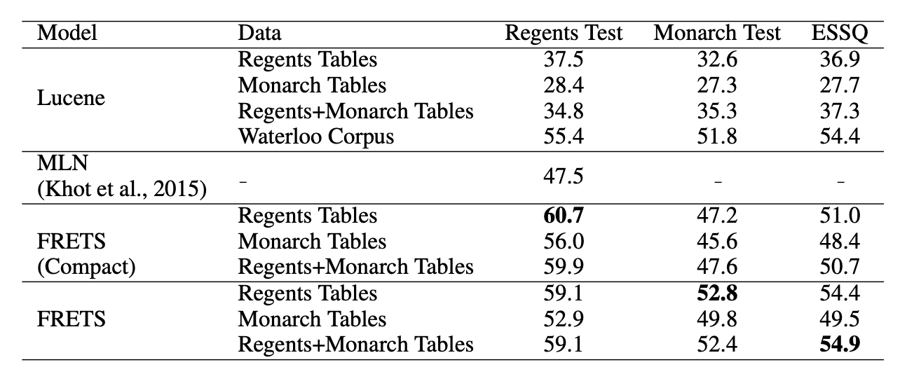
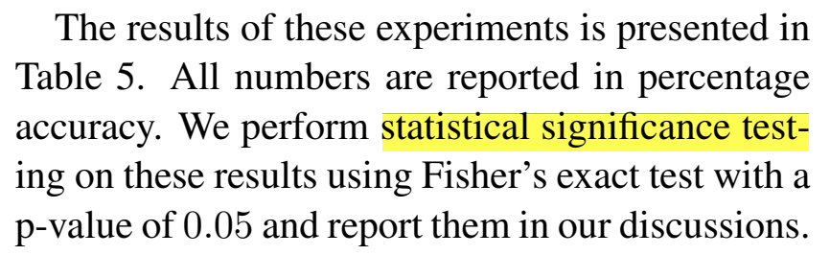
Omission of hypotheses
(EMNLP 2018)
?
S1 >> S2
Statistical Tool
Hypothesis
Research Question
Flawed practice: Many works use hypothesis assessment tests without knowing/stating their hypothesis.
Notes:
Here is a real example of that: a screenshot from a paper public at EMNLP 2019
There is a table of results, just like what we had earlier
The research question is clear from the context
The text also mentions what statistical tool they use.
But what is their hypothesis or scientific claim their pursuing to assess? Unclear.
This is an output; in fact, this is a systemic flaw practice I the field. (read)

Slide 13
Talk Summary & Statement
There are several serious malpractices:
Incomplete reporting of hypotheses and how they address research questions.
Inability to interpret statistical tools or their results.
Lack of awareness about various Bayesian hypothesis assessment tools.
Research works should be explicit about:
(a) Their choice of hypothesis and,
(b) How selected statistical tool addresses this hypothesis.
Notes:
Overall, this work/presentation is motivated by the observation that there seems to be limited understanding about: (read)
The key tip we’re offering is that: (read)

Slide 14
Statistical tools in this work . . .
Frequentist
Bayesian
Binary/Categorical Decisions
Null-Hypothesis Significance Test
Bayes Factor
Uncertainty Estimations
Confidence Interval
Posterior Intervals
(Kruschke and Liddell, 2018)
Notes:
In particular, here we see the statistical tools that we study in the paper are: (read them)
The two tools on the left are based on frequentist statistics, while the ones on the right are based on Bayesian inference. This categorization is based on what inference tool they use: ….
Bayesian probability is the name given to several related interpretations of probability as an amount of epistemic confidence – the strength of beliefs, hypotheses etc. – rather than a frequency.
A complementary categorization of these tools is based on the nature of the results that they provide: the ones on the top encourage binary decision making, while those on the bottom provide uncertainty around estimates.
For the sake of this presentation, to make the talk more focused, we’re going to focus on the red algorithms, but in our paper we cover all 4 of them.
NHST, because it’s the most popular choice
PI, because I believe it’s a useful alternative.

Slide 15
Frequentist
Bayesian
Binary/Categorical Decisions
Null-Hypothesis Significance Test
Bayes Factor
Uncertainty Estimations
Confidence Interval
Posterior Intervals

Slide 16
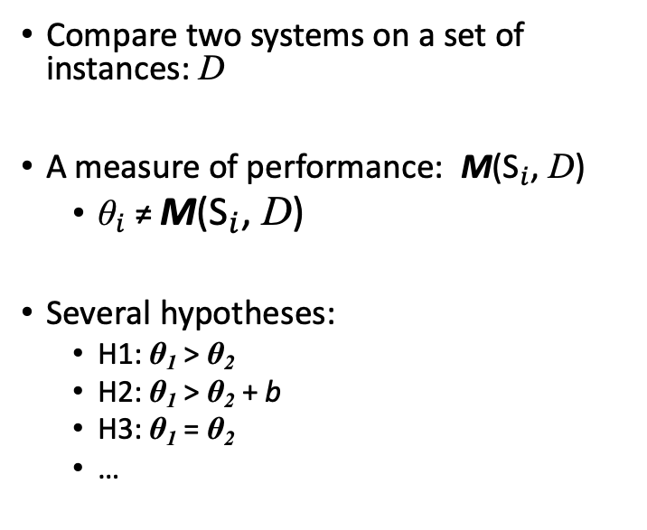
Notation
Input instances: D
Claims about the inherent properties θ₁,θ₂ of the two systems.
Compare two systems on a set of instances: D
A measure of performance: M(${\text{S}}_{i}$, D)
${\text{θ}}_{i}$≠ M(${\text{S}}_{i}$, D)
Several hypotheses:
H1: θ₁ > θ₂
H2: θ₁ > θ₂ + b
H3: θ₁ = θ₂
…
S1
S2
Metric M
Hypotheses
Hypothesis Assessment
Observations
Conclusions validating
(or not) the hypotheses.
Notes:
Before getting into any gory details, let’s fix our notation for the rest of the presentation:
Suppose we want to compare two systems on a dataset of instances D with respect to a measure M(S, x) representing the performance of system S on an instance x.
Let M(S, D) denote the vector …..
In a typical NLP experiment, the goal is to infer some inherent and unknown properties of systems.
To this end, a practitioner assumes a probability distribution on the observations y, parameterized by θ, the properties of the systems.
In other words, y is assumed to have a distribution with unknown parameters θ. In this setting, a hypothesis H is a condition on θ.
Hypothesis assessment is a way of evaluating the degree to which the observations y are compatible with H.
For this task, the performance metric M(S, x) is defined as a binary function indicating whether a system S answers a given question x correctly or not.
The performance vector M(S, x) captures the system’s accuracy on the entire dataset.
We assume that each system Si has an unknown inherent accuracy value, denoted θi .
Let θ = [θ1, θ2] denote the unknown inherent accuracy of two systems.
In this setup, one might, for instance, be interested in assessing the credibility of the hypothesis H that θ1 < θ2.

Slide 17
Null-Hypothesis Significance Testing
The goal is to decide whether a particular hypothesis can be rejected.
Make a hypothesis (that you want it to be rejected): null-hypothesis.
Assume that null-hypothesis is correct.
Calculate the probability of getting an outcome as “extreme” or more than the observed outcome.
This probability is called a “p-value.”
H₀: θ₁ =θ₂
e.g., a bigger accuracy improvement.
(Søgaard et al., 2014; Koehn, 2004; Dror and Reichart, 2018)
Notes:
In frequentist hypothesis testing, there is an asymmetric relationship between two hypotheses.
The hypothesis formulated to be rejected is usually called the null-hypothesis H0.
For instance, in our example H0: θ1 = θ2.
We define a probability, under the null-hypothesis H0, of observing an outcome at least equal to or extreme than the empirical observations y.
In this context, "extremeness" depends on the definition of your problem;
if you're comparing the accuracies of two systems, extremeness for example means increasing the accuracy of your system.
If you're adding a featuring to S2, you can define extremeness based on an estimate of monthly users.
And let's pick a name for this probability, since it's going to come up many times.

Slide 18


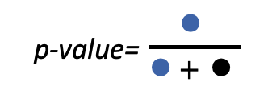
P-value, Visualized
Null-hypothesis: a hypothesis you want to reject & assume that it is correct.
P-value: the probability of getting an outcome as “extreme” or more than the observed outcome.
A small p-value is used as a stronger evidence towards rejecting the null-hypothesis.
“extremer” outcomes
bigger
p-value
the actual outcome
😭
p-value=$\frac{\text{●}}{\text{●}+ \text{●}}$
all possible outcomes
Notes:
Since p-value is a pivotal notion here, let's try to visualize it, to make better sense of it.
So we did say that null-hypothesis is (read)
And we did define p-value as (read)
The first step to image is to understand the space of all "outcomes"

Slide 19
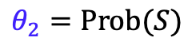
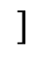
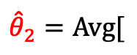
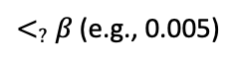
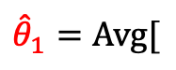
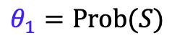
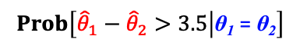
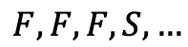
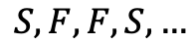
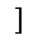
Null-Hypothesis Significance Testing: Example
Hypothesis H1: θ₁ > θ₂
Null-Hypothesis H0: θ₁ = θ₂
$$θ_{1}=Prob(S)$$
System | Accuracy
Ⓐ | 72.4%
Ⓑ | 68.9%
$${\hat{θ}}_{1}=Avg[$$
$$]$$
$$S, F,F,S,…$$
$$θ_{2}=Prob(S)$$
$${\hat{θ}}_{2}=Avg[$$
$$F, F,F,S,…$$
$$]$$
One-sided z-test
P-value=
$$Prob\left[{\hat{θ}}_{1}−{\hat{θ}}_{2}>3.5 | \text{θ}\text{1} \text{=} \text{θ}\text{2}\right]$$
$<_{?}$ $β$ (e.g., 0.005)
Notes:
We formulate a null-hypothesis against the claim of S1 having strictly better accuracy than S2.
This results in a p-value of 0.0037 and can be interpreted as the following: if the systems have inherently identical accuracy values, the probability of observing a superiority at least as extreme as our observations is 0.0037.
For a significance level of 0.05 (picked before the test) this p-value is small enough to reject the null-hypothesis.
Ya all this time you thought there are Transformers; but it was all a bunch of bored gineas (haha)
called z-test which is applicable to particular scenarios with some strict assumptions.

Slide 20
Interpreting p-values
Pretty complex notion!
“The probability of obtaining test results at least as extreme as the results actually observed during the test, assuming that the null-hypothesis is correct.” --your favorite statistics textbook
Notes:
Let me add a couple of remarks about interpreting p-values.
I personally struggled with this notion for years, and I thought it’s only me; until a stat teacher of mine told me that it’s not just me.

Slide 21
Interpreting p-value
If p < 0.05, the null-hypothesis has only a 5% chance of being true
Remember that p-value is defined with the assumption that null-hypothesis is correct.
(Demsar, 2008; Goodman, 2008)
Notes:
Here are a few common misinterpretations (Demsar ˇ , 2008; Goodman, 2008):

Slide 22
Interpreting p-value
If p > 0.05, there is no difference between the two systems
Having a large p-value only means that the null-hypothesis is consistent with the observations,
… but it does not tell anything about the likeliness of the null-hypothesis.
(Demsar, 2008; Goodman, 2008)

Slide 23
Interpreting p-value
A statistically significant result (p < 0.05) indicates a large/notable difference between two systems.
P-value only indicates strict superiority and provides no information about the margin of the effect.
(Demsar, 2008; Goodman, 2008)
Notes:
It’s false, by induction …
At least, the common tests.

Slide 24
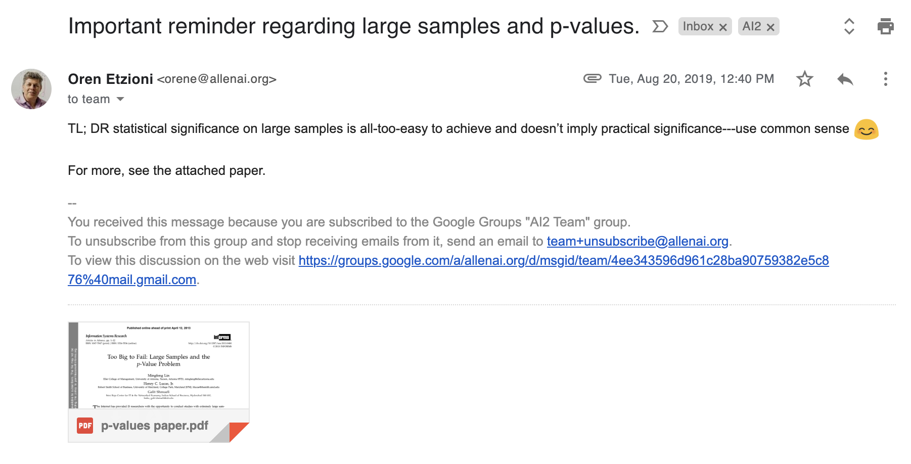
Remember this?
Or just keep listening to Daniel’s presentation!
Notes:
Ignore the pun at the end-- Oren being Oren.

Slide 25
Intermediate Summary
P-values do not provide probability estimates on two classifiers being different (or equal).
Statistical significance is different than practical significance.
Point-wise null hypotheses could be misused: for big enough data points it is possible to make statistically significant claims.
Frequentist
Bayesian
Binary Decision
Null-Hypothesis Significance Test
Bayes Factor
Uncertainty Estimations
Confidence Interval
Posterior Intervals
Notes:
Inherently, NHST is not designed to answer such queries about uncertainty of claims/hypotheses.

Slide 26
Frequentist
Bayesian
Binary/Categorical Decisions
Null-Hypothesis Significance Test
Bayes Factor
Uncertainty Estimations
Confidence Interval
Posterior Intervals

Slide 27
Posterior Intervals
Based on Bayesian inference framework.
(Thomas Bayes 1702-1761)
Notes:
This assessment tool is based on Bayesian Inference framework:
When I say inference, here is a rough description:
You receive an input (e.g., "fourcandles")
So you're confused; don't know what it means.
You want to infer: whether it was meant to be "four candles" or "fork handles"
the creation of Thomas Bayes.
Thomas Bayes was an English minister who also had interests in statistics.
He had notes on calculating probability of events based on observations, in several limited settings.
After his death, his friends publish his notes and many realize that these ideas are much more general.
And this in turn results in a vast literature of “inference” techniques.
And the key equation that will help us do this inference is the Bayes theorem.

Slide 28
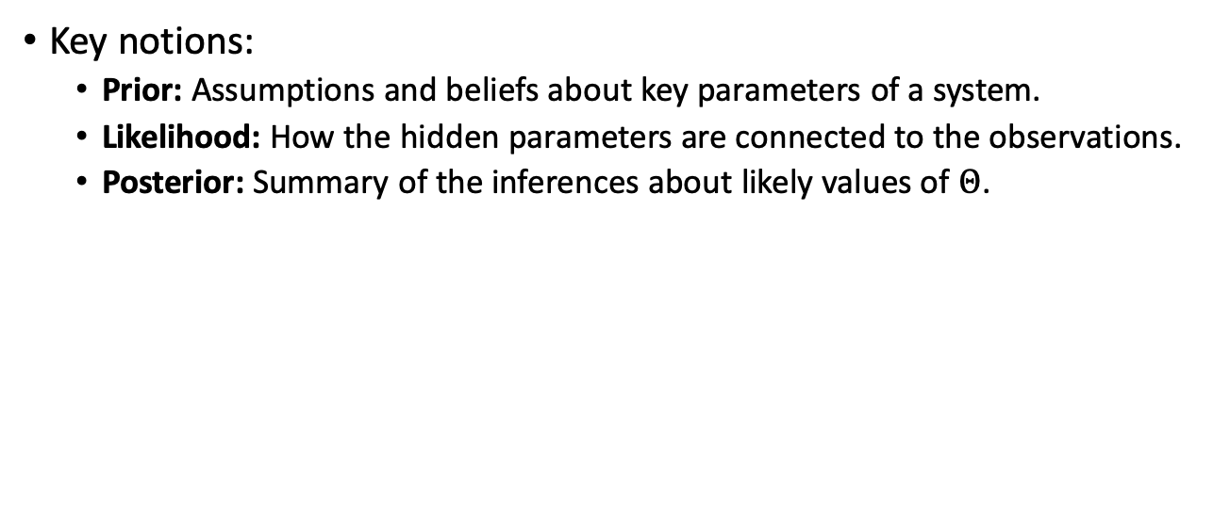
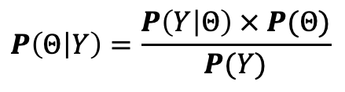
Posterior Intervals
Key notions:
Prior: Assumptions and beliefs about key parameters of a system.
Likelihood: How the hidden parameters are connected to the observations.
Posterior: Summary of the inferences about likely values of $Θ$.
$$P\left(Θ | Y\right)=\frac{P\left(Y | Θ\right) × P(Θ)}{P(Y)}$$
Notes:
To refereshen your mind about the Bayes' theorem:
In Bayesian inference frameworks, the specification of a priori assumptions and beliefs are encoded in the form of a prior distribution P(θ) on parameters of the model.
Recall that in a typical NLP experiment, these parameters can be, e.g., the actual mean or standard deviation for the performance of a system, as its inherent and unobserved property.
Formally, one incorporates θ in a hierarchical model in the form of a likelihood function P(y|θ).
This explicitly models the underlying process that connects the latent parameters to the observations.
Consequently, a posterior distribution is inferred using the Bayes rule and conditioned on the observations.
The posterior distribution is a combined summary of the data and prior information, about likely values of θ.
Additionally, the posterior can be used to describe the uncertainty around the mode.

Slide 29
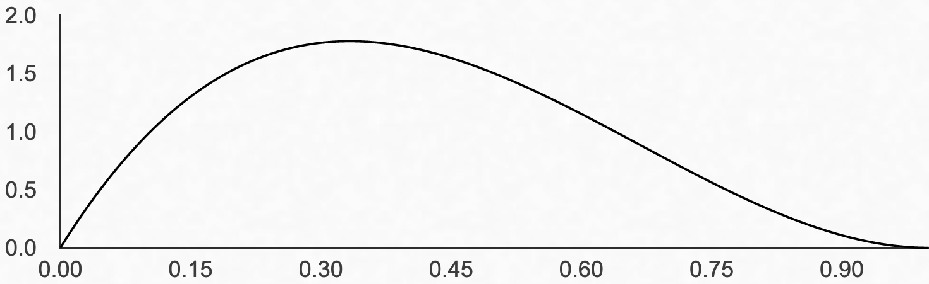

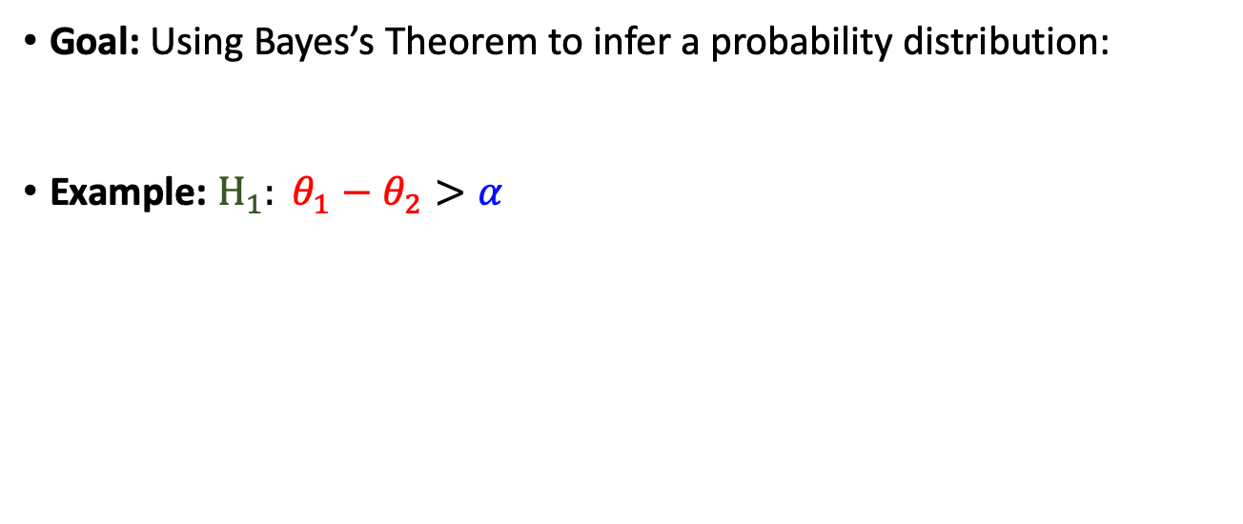
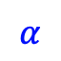
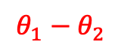
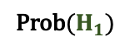
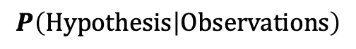
Posterior Intervals
Goal: Using Bayes’s Theorem to infer a probability distribution:
Example: $H_{1}: θ_{1}−θ_{2}>α$
$$P\left(Hypothesis | Observations\right)$$
Prob($H_{1})$
$$θ_{1}−θ_{2}$$
$$α$$
Notes:
The overall goal of this inference is to compute a probablity distribution defined based on your desired hypothesis, conditioned on what is observations.
Let me try to illustrate this point using our example.

Slide 30
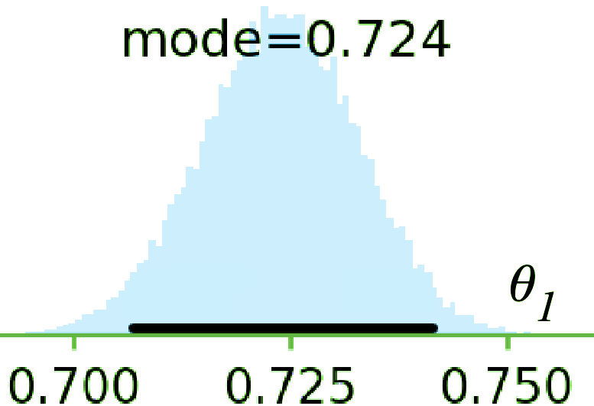
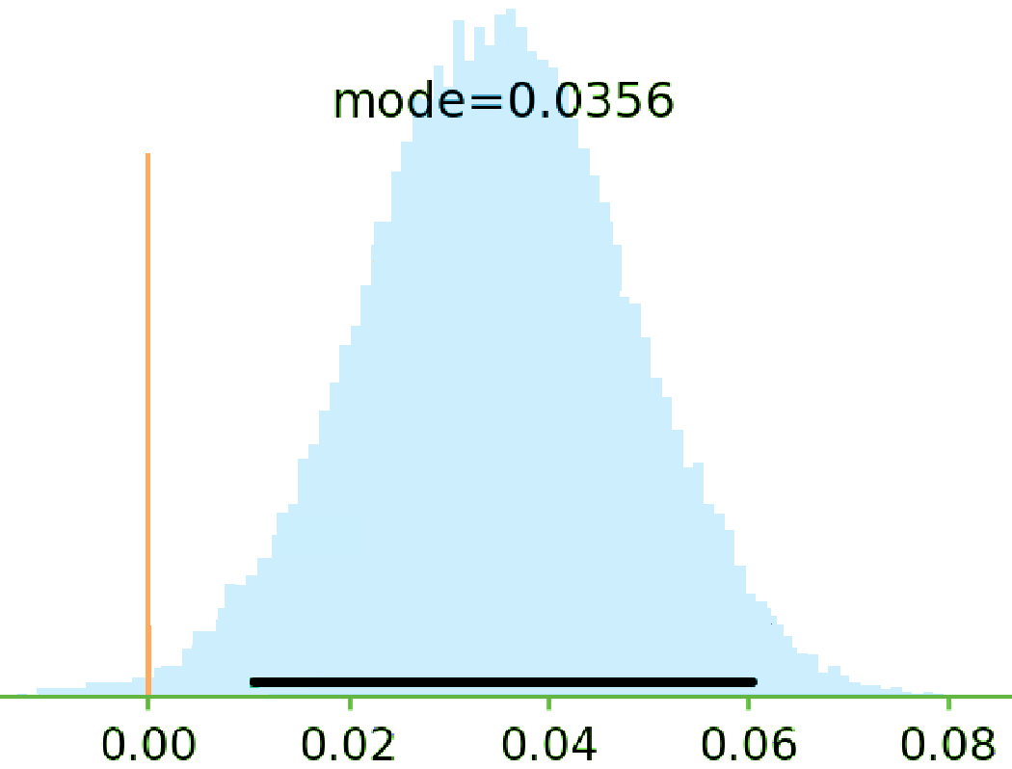
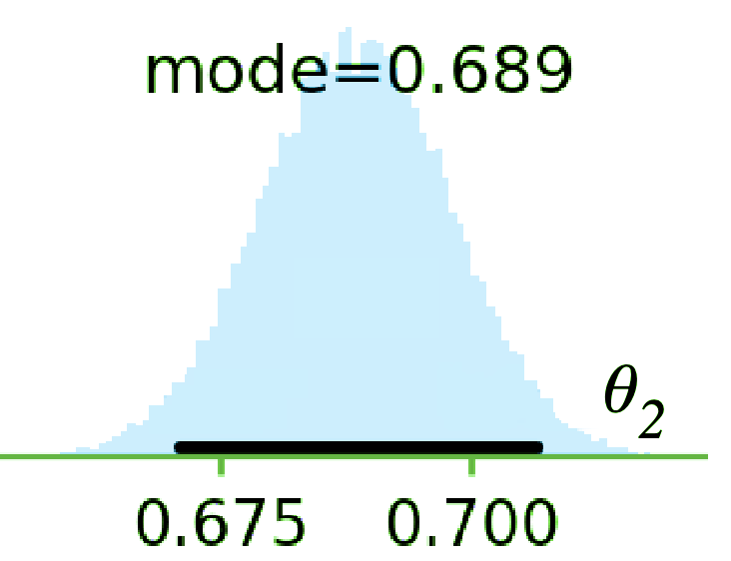
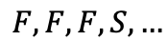
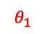
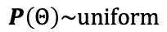
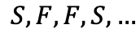
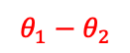
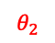
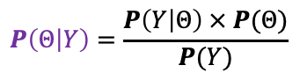
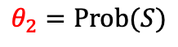
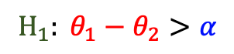
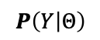
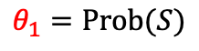
Posterior Intervals: Example
System | Accuracy
Ⓐ | 72.4
Ⓑ | 68.9
$$H_{1}: θ_{1}−θ_{2}>α$$
$$θ_{1}=Prob(S)$$
Ⓐ
$$θ_{1}$$
$$S, F,F,S,…$$
$$θ_{2}=Prob(S)$$
Ⓑ
$$F, F,F,S,…$$
$$θ_{2}$$
$$θ_{1}−θ_{2}$$
$$P\left(Y | Θ\right)$$
⊕
$$P\left(Θ | Y\right)=\frac{P\left(Y | Θ\right) × P(Θ)}{P(Y)}$$
$$P\left(Θ\right)\sim uniform$$
Notes:
One way to summarize the uncertainty around the point estimate of parameters is by marking the span of values that cover α% most-credible density in the posterior distribution (e.g., α = 95%).
This notion is called the Highest Density Intervals (HDIs), or Bayesian Confidence Intervals (Oliphant, 2006)
Recall that a hypothesis H is a condition on θ (see Fig.1).
Therefore, given the posterior P(θ|y), one can calculate the probability of H, as a probabilistic event, conditioned on y: P(H|y).
For example in an unpaired t-test, H0 is the event that the means of two groups are equal.
Bayesian statisticians usually relax this strict equality θ1 = θ2 and instead evaluate the credibility of |θ1 − θ2| < ε for some small value of ε.
The intuition is that when θ1 and θ2 are close enough they are practically equivalent.
This motivates the definition of Region Of Practical Equivalence (ROPE): An interval around zero with “negligible” radius.
The boundaries of ROPE depend on the application, the meaning of the parameters and its audience. In our running example, a radius of one percent for ROPE implies that improvements less than 1 percent are not considered notable.

Slide 31
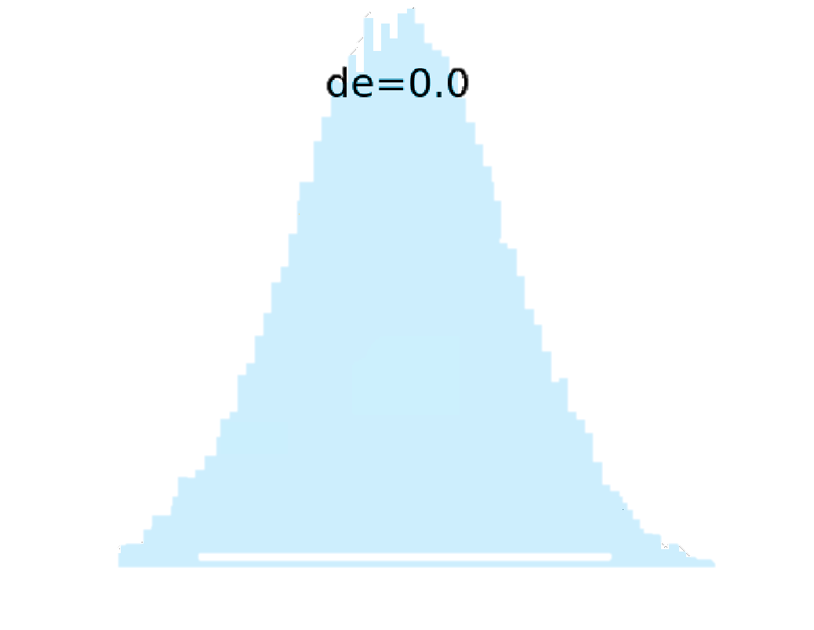
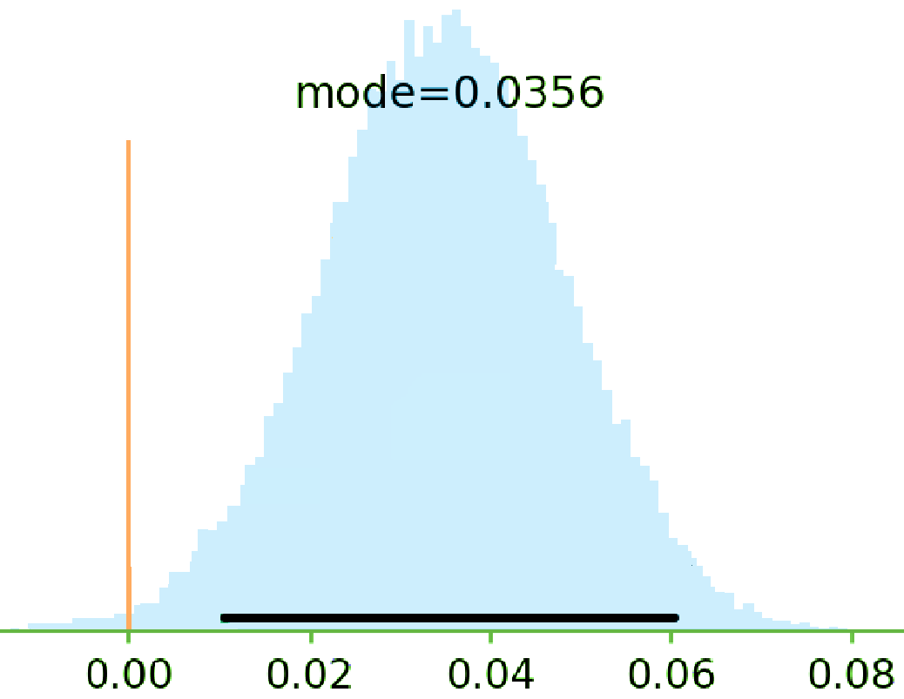
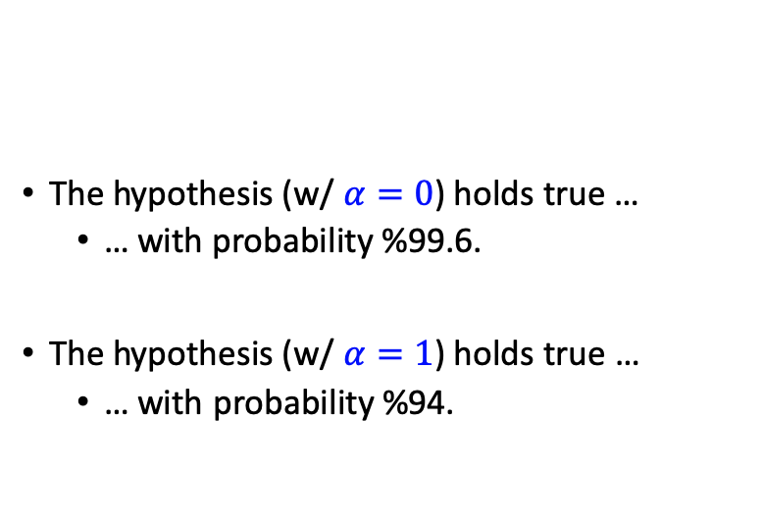
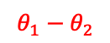
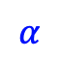
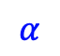
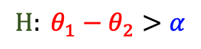
Posterior Intervals: Example
System | Accuracy
Ⓐ | 72.4
Ⓑ | 68.9
The hypothesis (w/ $α=0$) holds true …
… with probability %99.6.
The hypothesis (w/ $α=1$) holds true …
… with probability %94.
$$H: θ_{1}−θ_{2}>α$$
$$θ_{1}−θ_{2}$$
$$α$$
$$α$$
Notes:
Recall the setting from previous examples. The left panel of Fig. 2 shows the prior on the latent accuracy values of the systems and their differences (further details on the hierarchical model in §A.3.) Then the posterior distribution (Fig.2, right) is obtained (in this case, through numerical methods).
Notice that one can read the following conclusion that with a probability 0.996 the hypothesis H3 (with x = 0) holds true.
As it will be mentioned earlier, this statement does not imply any difference with a notable margin.
In fact, the posterior in Fig.2 implies that this experiment is not sufficient to claim the following statement: with probability at least 0.95 the hypothesis H3 (with x = 1) holds true.

Slide 32
2nd Intermediate Summary
It’s much more intuitive to work with the probability of hypotheses.
Easier to interpret → less ambiguous.
Provides a flexible framework
E.g., margin of superiority could incorporated in the definition of hypotheses.
This does not encourage binary decision-making.
Frequentist
Bayesian
Binary Decision
Null-Hypothesis Significance Test
Bayes Factor
Uncertainty Estimations
Confidence Interval
Posterior Intervals
Notes:
Took much faster to present this 2nd part; maybe an indication that it was simpler? (haha)
Let me try to summarize.

Slide 33
Final Section: Common Practices, Comparisons and Suggestions
Frequentist
Bayesian
Binary/Categorical Decisions
Null-Hypothesis Significance Test
Bayes Factor
Uncertainty Estimations
Confidence Interval
Posterior Intervals

Slide 34

Survey of the NLP Community
A questionnaire containing general and specific questions about significance assessment tools
Sent it to over 400 researchers randomly selected from ACL’18 proceedings
~50 individuals responded
Notes:
During this work we conduct a survey in our community,
Where we had (read)
As you’d imagine, not everyone was happy about being asked to fill out a survey; so sometimes we’d receive replies like this.

Slide 35
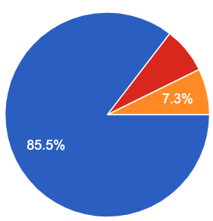
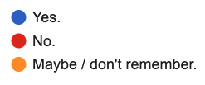
Survey of the NLP Community
“I have learned about statistical hypothesis testing/assessment (via taking classes or reading it from other places).”

Slide 36
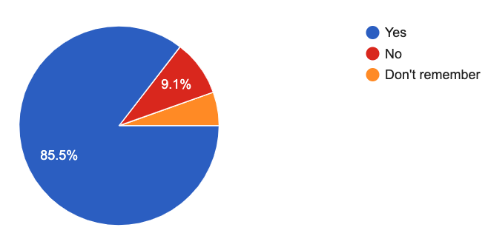
Participants in Our Survey
“I have used "hypothesis testing" in the past (in a homework, a paper, etc.)”

Slide 37
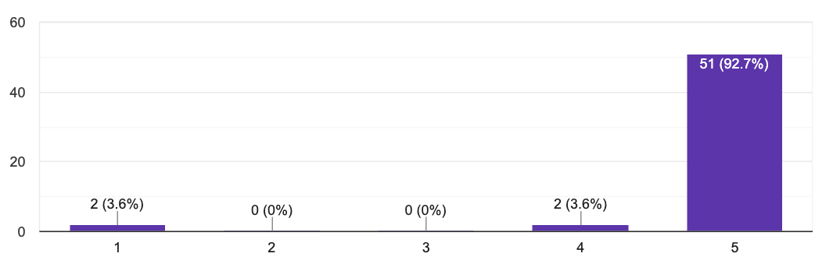
Participants in Our Survey
“I am not a robot”
Notes:
We included a question to check if people are paying attention to what they’re reading or not.
… turns out that 2 of our human participants self-identified as robots.
And 2 people considered themselves partially a robot.
If people don’t laugh: just to make sure, this is not funny, or I am surrounded by a bunch of robots?

Slide 38
Trends and Patterns in the field
Study NLP conference papers: ACL’18 papers (439 papers)
How many papers did use significance testing?
Frequentist
Bayesian
73
0
Binary Decision
Null-Hypothesis Significance Test
Bayes Factor
Uncertainty Estimations
Confidence Interval
Posterior Intervals
Why?
6
0
Notes:
To better understand the common practices or misinterpretations in the field, we conduct a survey.
We share the survey among ∼450 NLP researchers (randomly selected from ACL’18 Proceedings) from which 55 individuals filled out the survey.
Now the question is what is the reason behind this imbalanced usage of the statistical tools;
Is this an informed decision to behave this way?
Or it is sth something else.

Slide 39
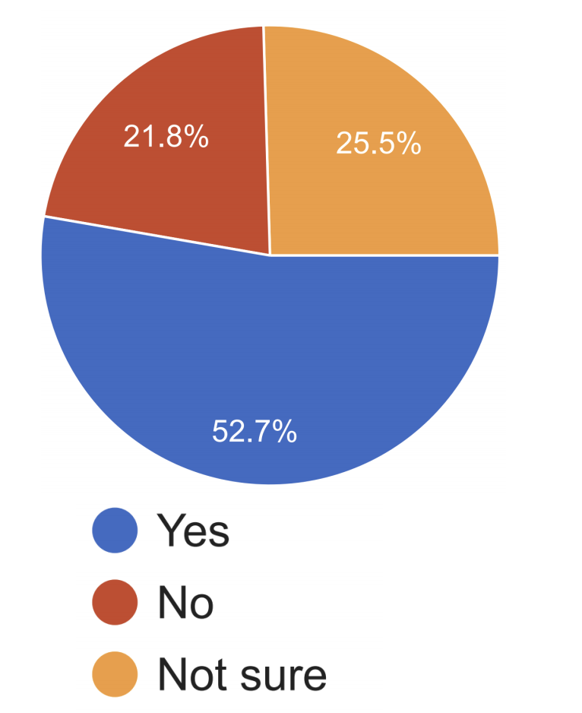
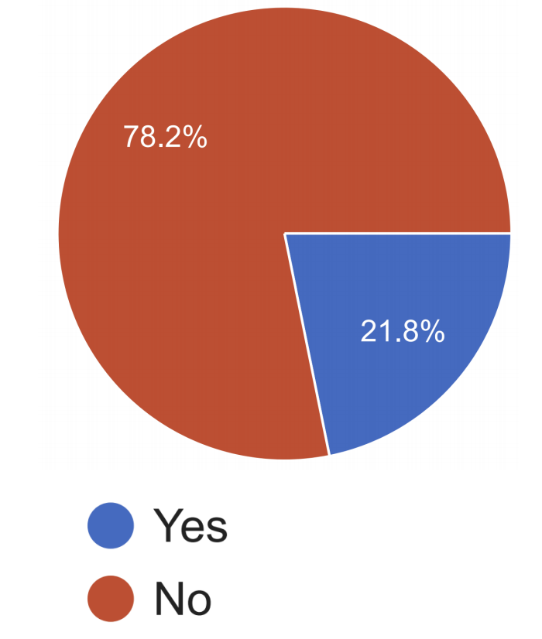
Have you heard about "Bayesian Hypothesis Testing"?
Do you know the definition of "Bayes Factor"?
Many people did not know the definition of “Bayes Factor” and some only had “heard” about them. 🤔
Notes:
The point here is that: maybe we have a lack of exposure problem in the field, possibly because these definitions are not included in their academic curiculum.

Slide 40
Measures of [Un]Certainty
P-values do not provide probability estimates on validity of hypotheses.
Posterior Intervals are interpretable in terms of post-data probabilities.
Frequentist
Bayesian
👎🏽
👎🏽
Binary Decision
Null-Hypothesis Significance Test
Bayes Factor
Uncertainty Estimations
Confidence Interval
Posterior Intervals
😑
👍🏽
(Goodman, 2008; Wasserstein et al., 2016)
Notes:
p-values do not provide probability estimates on the systems being different (or equal) (Goodman, 2008; Wasserstein et al., 2016)
reporting posterior intervals generally provides the most useful summary as they provide uncertainty estimates.
😑 Expressionless Face Emoji

Slide 41
Susceptibility to Misinterpretation
The complexity of interpreting significance tests could result in ambiguous or misleading conclusions.
P-values, while being the most common approach, are inherently complex and easy to misinterpret.
Frequentist
Bayesian
👎🏽
Binary Decision
Null-Hypothesis Significance Test
Bayes Factor
Uncertainty Estimations
Confidence Interval
Posterior Intervals
😑
Notes:
The complexity of interpreting significance tests, combined with insufficient reporting (as shown by Dror et al. (2018)) could result in ambiguous or misleading conclusions. Not only many papers are unclear about their tests, but their results could also be misinterpreted by readers.
Among the techniques studied here, p-values, due to their complex definition, have received by far the biggest number of criticisms. While p-values are the most common approach, they are inherently complex which makes them easy to misinterpret.
😑 Expressionless Face Emoji

Slide 42

Participants in Our Survey
“I know p-values and I know how to interpret them.”

Slide 43
A Survey Question: Interpreting P-value
An NLP paper shows a performance of 38% for a classifier-1. They also show that adding a feature improves the performance to 45% (call this classifier-2). The authors claim that this finding is “statistically significant” with a significance level of 0.01. Which of the following(s) make sense?
The probability of observing a margin 7% is at most 0.01, assuming that the two classifiers inherently have the same performance.
If we repeat the experiment, with a probability 99% classifier-2 will have a higher performance than classifier-1.
🤦
23%
30%

Slide 44
Unintended Misleading Result by Iterative Testing
Reality
Expectation
Many tests are designed for a single-round experiment.
In practice researchers perform multiple rounds of experiments.
This is a major problem when using binary tests.
E.g., you can “hack” a p-value test, with enough repetitions.
Start
Start
???
End
Notes:
While many tests are designed for a single-round experiment, in practice researchers perform multiple rounds of experiments until a predetermined condition is satisfied. This is particularly a problem in binary tests (such as p-value) when the condition is to achieve a desired result. For example, a researcher could continue experimenting until they achieve a statistically significant result (even if they don’t necessarily have any intention of cheating the test) (Kim and Bang, 2016).
p-values encourage binary thinking (Gelman, 2013; Amrhein et al., 2017). A binary significance test, can not say anything about the relative merits of two hypotheses (the null and alternative) since it is calculated assuming that the null-hypotheses is true
Since the outcomes of p-values and CIs only can “reject” or stay “undecided”, these tests reinforce an unintentional bias towards the only possible decision. Consequently, it becomes easy to misuse this testing mechanism: for big enough data points it is possible to make statistically significant claims (Amrhein et al., 2017).

Slide 45
The Need for Assumptions
Which tests have assumptions?
Assumptions are necessary to perform any statistical tests.
“no free lunch”
Many of them are questionable!
Frequentist
Bayesian
Binary Decision
Null-Hypothesis Significance Test
Bayes Factor
Uncertainty Estimations
Confidence Interval
Posterior Intervals
Notes:
All of them require assumptions
The key is to understand these assumptions and how these assumptions would affect the output of your conclusions.
All tests make assumptions, but each make different kind of assumptions.
This is to say that none of these tools are the gift of god; and their results could be false or misleading, depending on whether their assumptions are compatible with your setting or not.

Slide 46



Ambiguity problem in interpreting “significance”
Notes:
When you search for the term “significantly” among the collection of published NLP papers, there are more than 28k papers.
And often such phrasings appear in key parts of papers like their abstracts. Here are two, for example.
But the main issue is the “ambiguity” problem in interpreting such phrases. In particular, it is not clear whether …

Slide 47
Ambiguity problem in interpreting “significance”
An NLP paper presents system-1 and it compares it with a baseline system-2. In its “abstract” it writes: “... system-1 significantly improves over system-2.” What are the right way(s) to interpret this (select all that applies)
It is expected that authors have performed some type of “hypothesis testing.”
It is expected that the authors have reported the performances of two systems on a dataset where system-1 has a higher performance than system-2 with a notable margin in the dataset.
83%
53%
Notes:
We wanted to verify this; so we included a question in our survey.
We asked out participants ….

Slide 48
The Usage of “Significance”: Our Recommendation
When referring to performing some type of “hypothesis testing,” use prefixes like “statistical”
When referring to big empirical improvements, use alternative terms like: “notable” or “remarkable.”

Slide 49
Tips and Suggestions
Frequentist
Bayesian
Binary Decision
Null-Hypothesis Significance Test
Bayes Factor
Define the research hypothesis you are after:
Uncertainty Estimations
Confidence Interval
Posterior Intervals
C1: Ⓐ and Ⓑ are inherently different, in the sense that if they were inherently identical, it would be highly unlikely to witness the observed 3.5% empirical gap.
C2: Ⓐ and Ⓑ are inherently different, since with probability at least 95%, the inherent accuracy of Ⓐ exceeds that of Ⓑ by at least 𝛼%.
…

Slide 50
Tips and Suggestions
Frequentist
Bayesian
Binary Decision
Null-Hypothesis Significance Test
Bayes Factor
If using frequentist tests:
The statements reporting p-value and confidence interval need to be precise.
… so that the results are not misinterpreted.
The term “significant” should be used with caution and clear purpose in order to not cause any misinterpretations.
better under a significance test != significantly better
One way to achieve this is by using adjectives “statistical” or “practical” before any (possibly inflected) usage of “significance.”
Uncertainty Estimations
Confidence Interval
Posterior Intervals

Slide 51

Tips and Suggestions
Frequentist
Bayesian
Binary Decision
Null-Hypothesis Significance Test
Bayes Factor
Uncertainty Estimations
Confidence Interval
Posterior Intervals
Lots of good tips about:
Selecting the right “test”
How to report your results.

Slide 52
Tips and Suggestions
If using Bayesian tests:
Be clear about your hierarchical model, any parameters in the model and the choice of priors.
Comment on the certainty (or the lack of) of your inference.
Frequentist
Bayesian
Binary Decision
Null-Hypothesis Significance Test
Bayes Factor
Uncertainty Estimations
Confidence Interval
Posterior Intervals

Slide 53

HyBayes Package
Notes:
We contribute a new toolkit, HyBayes, to make it easy for NLP practitioners to use Bayesian assessment in their efforts. We hope that this work provides a complimentary picture of hypothesis assessment techniques for the field and encourages a more rigorous treatment of such techniques.

Slide 54


Slide 55
That’s it!

Slide 56




Participants in our Survey

Slide 57

Participants in our Survey

Slide 58

Participants in Our Survey
“I can understand almost all the "statistical" terms I encounter in papers.”

